Slide 1
Software Configuration Management
Matakuliah Rekayasa Perangkat Lunak (CS215) – Gasal 2015/2016
Magister Ilmu Komputer - Universitas Budi Luhur
Achmad Solichin, S.Kom, M.T.I (achmatim@gmail.com)

Slide 2
Overview
Software Configuration Items
SCM International Standard
Software Configuration identification
Software Configuration version control
Software Configuration change control
Software Configuration auditing
Software Configuration reporting

Slide 3
The “First Law” of System Engineering
No matter where you are in the system life cycle, the system will change, and the desire to change it will persist throughout the life cycle. [Bersoff et al, 1980]

Slide 4
Source of Change
New business or market conditions
New stakeholder needs demand modification
Reorganization or business growth/downsizing
Budgetary or scheduling

Slide 5
Software Change Management
Software configuration management (SCM), also called change management, is a set of activities designed to manage change by identifying the work products that are likely to change, establishing relationships among them, defining mechanisms for managing different versions of these work products, controlling the changes imposed, and auditing and reporting on the changes made.

Slide 6
Purpose of SCM
Identify change
Control change
Ensure that change is being properly implemented
Report changes to others who may have an interest

Slide 7
The Software Configuration
programs
documents
The pieces
data

Slide 8
Baseline
The IEEE (IEEE Std. No. 610.12-1990) defines a baseline as:
A specification or product that has been formally reviewed and agreed upon, that thereafter serves as the basis for further development, and that can be changed only through formal change control procedures.
a baseline is a milestone in the development of software that is marked by the delivery of one or more software configuration items and the approval of these SCIs that is obtained through a formal technical review

Slide 9
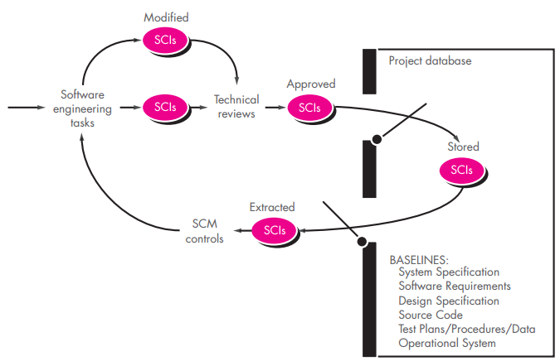
Baseline

Slide 10
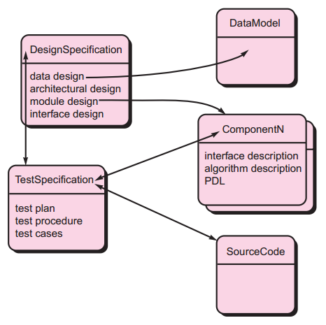
Software Configuration Objects
SCIs are organized to form configuration objects that may be cataloged in the project database with a single name

Slide 11
SCM Repository
The SCM repository is the set of mechanisms and data structures that allow a software team to manage change in an effective manner
The repository performs or precipitates the following functions [For89]:
Data integrity
Information sharing
Tool integration
Data integration
Methodology enforcement
Document standardization

Slide 12
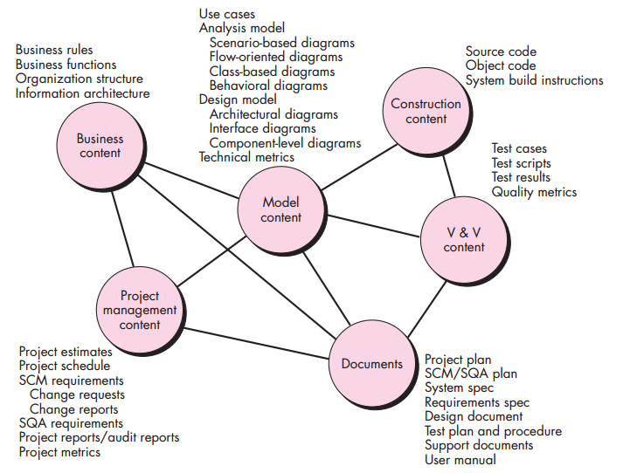
SCM Repository

Slide 13
Repository Features
Versioning.
saves all of these versions to enable effective management of product releases and to permit developers to go back to previous versions
Dependency tracking and change management.
The repository manages a wide variety of relationships among the data elements stored in it.
Requirements tracing.
Provides the ability to track all the design and construction components and deliverables that result from a specific requirement specification
Configuration management.
Keeps track of a series of configurations representing specific project milestones or production releases. Version management provides the needed versions, and link management keeps track of interdependencies.
Audit trails.
establishes additional information about when, why, and by whom changes are made.

Slide 14
SCM Elements
Component elements—a set of tools coupled within a file management system (e.g., a database) that enables access to and management of each software configuration item.
Process elements—a collection of procedures and tasks that define an effective approach to change management (and related activities) for all constituencies involved in the management, engineering and use of computer software.
Construction elements—a set of tools that automate the construction of software by ensuring that the proper set of validated components (i.e., the correct version) have been assembled.
Human elements—to implement effective SCM, the software team uses a set of tools and process features (encompassing other CM elements)

Slide 15
The SCM Process
Addresses the following questions …
How does a software team identify the discrete elements of a software configuration?
How does an organization manage the many existing versions of a program (and its documentation) in a manner that will enable change to be accommodated efficiently?
How does an organization control changes before and after software is released to a customer?
Who has responsibility for approving and ranking changes?
How can we ensure that changes have been made properly?
What mechanism is used to appraise others of changes that are made?

Slide 16
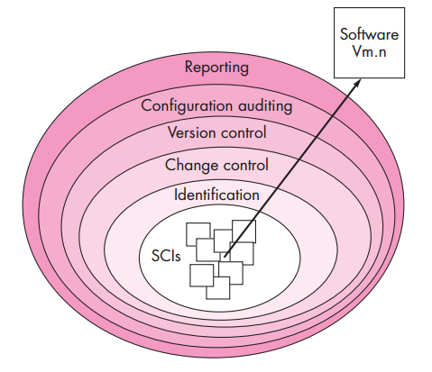
SCM Process

Slide 17
Version Control
Version control combines procedures and tools to manage different versions of configuration objects that are created during the software process
A version control system implements or is directly integrated with four major capabilities:
a project database (repository) that stores all relevant configuration objects
a version management capability that stores all versions of a configuration object (or enables any version to be constructed using differences from past versions);
a make facility that enables the software engineer to collect all relevant configuration objects and construct a specific version of the software.
an issues tracking (also called bug tracking) capability that enables the team to record and track the status of all outstanding issues associated with each configuration object.

Slide 18
Concurrent Versions System (CVS)
The CVS is a widely used tool for version control
Originally designed for source code, but useful for any text-based file, the CVS system:
establishes a simple repository,
maintains all versions of a file in a single named file by storing only the differences between progressive versions of the original file, and
protects against simultaneous changes to a file by establishing different directories for each developer, thus insulating one from another.
CVS is available at no cost for Windows, Mac OS, LINUX, and UNIX environments http://savannah.nongnu.org/projects/cvs

Slide 19
Change Control
Change control is vital. But the forces that make it necessary also make it annoying. We worry about change because a tiny perturbation in the code can create a big failure in the product. But it can also fix a big failure or enable wonderful new capabilities. We worry about change because a single rogue developer could sink the project; yet brilliant ideas originate in the minds of those rogues, and a burdensome change control process could effectively discourage them from doing creative work [Bac98]
Too much change control and we create problems. Too little, and we create other problems

Slide 20
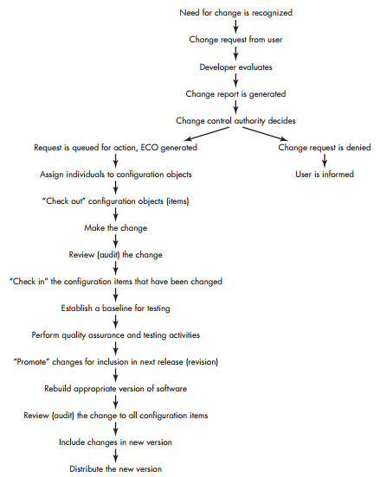

Slide 21
Auditing
Change
Requests
SQA
Plan
SCIs
SCM Audit

Slide 22
Status Accounting
Change
Reports
Change
Requests
ECOs
SCIs
Status Accounting
Reporting

Slide 23
SCM for Web Engineering
Content.
A typical WebApp contains a vast array of content—text, graphics, applets, scripts, audio/video files, forms, active page elements, tables, streaming data, and many others.
The challenge is to organize this sea of content into a rational set of configuration objects and then establish appropriate configuration control mechanisms for these objects.
People.
Because a significant percentage of WebApp development continues to be conducted in an ad hoc manner, any person involved in the WebApp can (and often does) create content.

Slide 24
SCM for Web Engineering
Scalability.
As size and complexity grow, small changes can have far-reaching and unintended affects that can be problematic. Therefore, the rigor of configuration control mechanisms should be directly proportional to application scale.
Politics.
Who ‘owns’ a WebApp?
Who assumes responsibility for the accuracy of the information on the Web site?
Who assures that quality control processes have been followed before information is published to the site?
Who is responsible for making changes?
Who assumes the cost of change?

Slide 25
Content Management
The collection subsystem encompasses all actions required to create and/or acquire content, and the technical functions that are necessary to
convert content into a form that can be represented by a mark-up language (e.g., HTML, XML
organize content into packets that can be displayed effectively on the client-side.
The management subsystem implements a repository that encompasses the following elements:
Content database—the information structure that has been established to store all content objects
Database capabilities—functions that enable the CMS to search for specific content objects (or categories of objects), store and retrieve objects, and manage the file structure that has been established for the content
Configuration management functions—the functional elements and associated workflow that support content object identification, version control, change management, change auditing, and reporting.

Slide 26
Content Management
The publishing subsystem extracts from the repository, converts it to a form that is amenable to publication, and formats it so that it can be transmitted to client-side browsers. The publishing subsystem accomplishes these tasks using a series of templates.
Each template is a function that builds a publication using one of three different components [BOI02]:
Static elements—text, graphics, media, and scripts that require no further processing are transmitted directly to the client-side
Publication services—function calls to specific retrieval and formatting services that personalize content (using predefined rules), perform data conversion, and build appropriate navigation links.
External services—provide access to external corporate information infrastructure such as enterprise data or “back-room” applications.

Slide 27
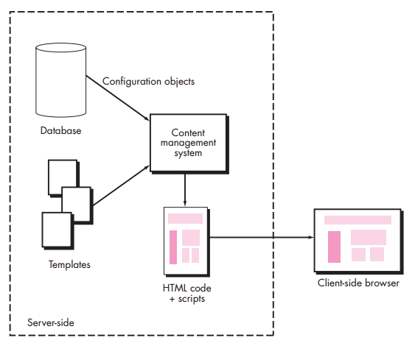
Content Management System

Slide 28
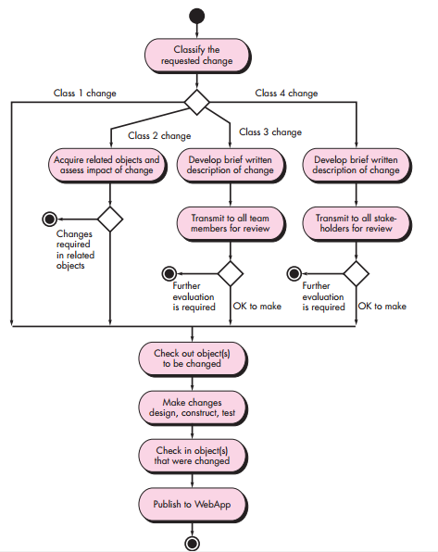
Change Management for Web Apps

Slide 29
References
Roger S. Pressman, 2010, Software Engineering: A Practitioner’s Approach 7th edition, McGraw-Hill.
Ian Sommerville, 2011, Software Engineering 9th edition, Addison-Wesley.
Other references

Slide 30
Thanks
Achmad Solichin, S.Kom, M.T.I
achmatim@gmail.com
Twitter: @achmatim
Facebook: facebook.com/achmatim
Web: http://achmatim.net

